Slide 1
INTERNATIONAL ECONOMICS PRESENTATION
SINGAPORE-THAILAND
By Group 3
Nishita Bansal
Pranav Bahl
Ranveer Aujla
Vaishaki Chowta
Ashmeet Singh
Yash Bera

Slide 2


 | SINGAPORE | THAILAND
GROSS DOMESTIC PRODUCT (G.D.P.) | $323.9 Billion $57714(per capita) | $455.22 Billion $6593.82(per capita)
POPULATION (2016) | 5.61 Million | 69 Million
EXPORTS TO Each Other | $13.76 Million (Singapore to Thailand) | $8.58 Million (Thailand to Singapore)

Slide 3
GRAVITY MODEL

Slide 4
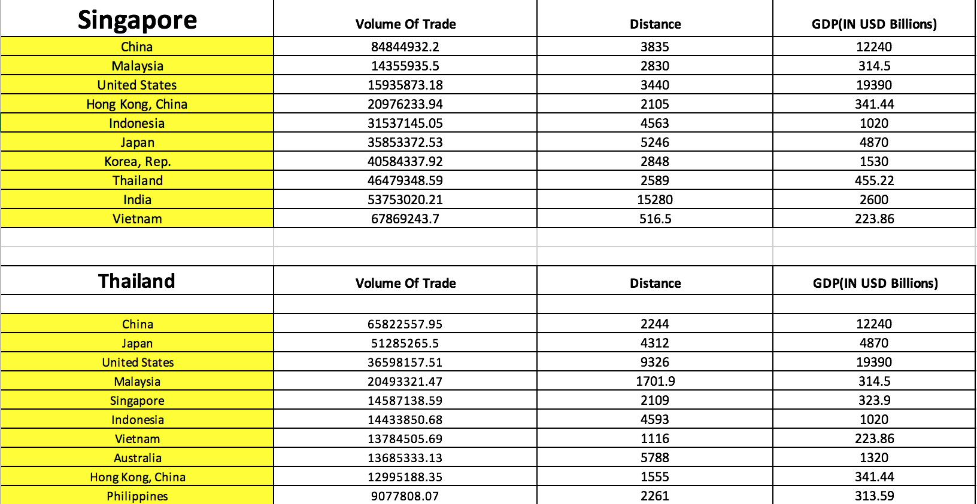

Slide 5
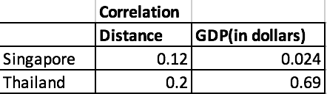

Slide 6
Comparative Advantage

Slide 7
Revealed Comparative Advantage
Revealed Comparative Advantage Index
Measures of revealed comparative advantage (RCA) have been used to help assess a country’s export potential.
The RCA indicates whether a country is in the process of extending the products in which it has a trade potential, as opposed to situations in which the number of products that can be competitively exported is static.
It can also provide useful information about potential trade prospects with new partners. Countries with similar RCA profiles are unlikely to have high bilateral trade intensities.

Slide 8
The RCA index of country “i” for product “j” is often measured by the product’s share in the country’s exports in relation to its share in world trade:
RCA_{ij} = (x_{ij}/X_{it}) / (x_{wj}/X_{wt})
Where x_{ij} and x_{wj} are the values of country i’s exports of product j and world exports of product j and where X_{it} and X_{wt} refer to the country’s total exports and world total exports.
A value of less than unity implies that the country has a revealed comparative disadvantage in the product. Similarly, if the index exceeds unity, the country is said to have a revealed comparative advantage in the product.

Slide 9
Revealed Comparative Advantage of Thailand Over Singapore
Product Group | 1989 | 1990 | 1991 | 1992 | 1993 | 2011 | 2012 | 2013 | 2014 | 2015
All Products | 1 | 1 | 1 | 1 | 1 | 1 | 1 | 1 | 1 | 1
Animal | 2.86 | 2.74 | 2.07 | 1.87 | 1.75 | 0.82 | 1.02 | 0.97 | 0.98 | 1.05
Chemicals | 0.27 | 0.32 | 0.32 | 0.25 | 0.18 | 0.69 | 0.71 | 1.24 | 1.23 | 1.06
Food Products | 0.9 | 0.78 | 0.63 | 0.73 | 0.66 | 1.87 | 1.86 | 1.91 | 1.93 | 1.79
Footwear | 2.05 | 1.85 | 1.6 | 1.15 | 0.95 | 0.49 | 0.44 | 0.39 | 0.38 | 0.42
Fuels | 0 | 0 | 0.04 | 0.2 | 0.16 | 1.27 | 1.35 | 1.17 | 1.02 | 1.06
Hides and Skins | 1.91 | 1.63 | 1.98 | 2.01 | 1.51 | 0.48 | 0.55 | 0.96 | 1.05 | 0.71
Mach and Elec | 1.2 | 1.43 | 1.55 | 1.6 | 1.57 | 0.92 | 0.89 | 0.93 | 1.02 | 1.06
Metals | 0.58 | 0.48 | 0.31 | 0.26 | 0.23 | 0.78 | 0.65 | 0.63 | 0.62 | 0.51
Minerals | 5.92 | 0.78 | 0.72 | 0.69 | 0.99 | 0.42 | 0.3 | 0.62 | 0.82 | 0.93
Miscellaneous | 0.52 | 0.32 | 0.4 | 0.32 | 0.34 | 0.36 | 0.35 | 0.38 | 0.37 | 0.38
Plastic or Rubber | 2.54 | 2.73 | 1.72 | 1.53 | 1.26 | 1.48 | 1.27 | 1.34 | 1.33 | 1.24
Stone and Glass | 1.04 | 0.7 | 1.63 | 1.48 | 1.23 | 0.72 | 0.56 | 0.82 | 0.86 | 0.7
Textiles and Clothing | 1.83 | 1.65 | 1.21 | 1 | 0.98 | 1.13 | 1.07 | 1.03 | 1.06 | 1.16
Transportation | 0.11 | 0.14 | 0.07 | 0.05 | 0.06 | 0.27 | 0.34 | 0.44 | 0.74 | 0.79
Vegetable | 3.07 | 3.14 | 2.32 | 1.88 | 1.7 | 2.33 | 2.28 | 2.84 | 2.8 | 2.53
Wood | 0.49 | 0.33 | 0.23 | 0.22 | 0.26 | 0.87 | 0.78 | 0.71 | 0.8 | 0.85

Slide 10
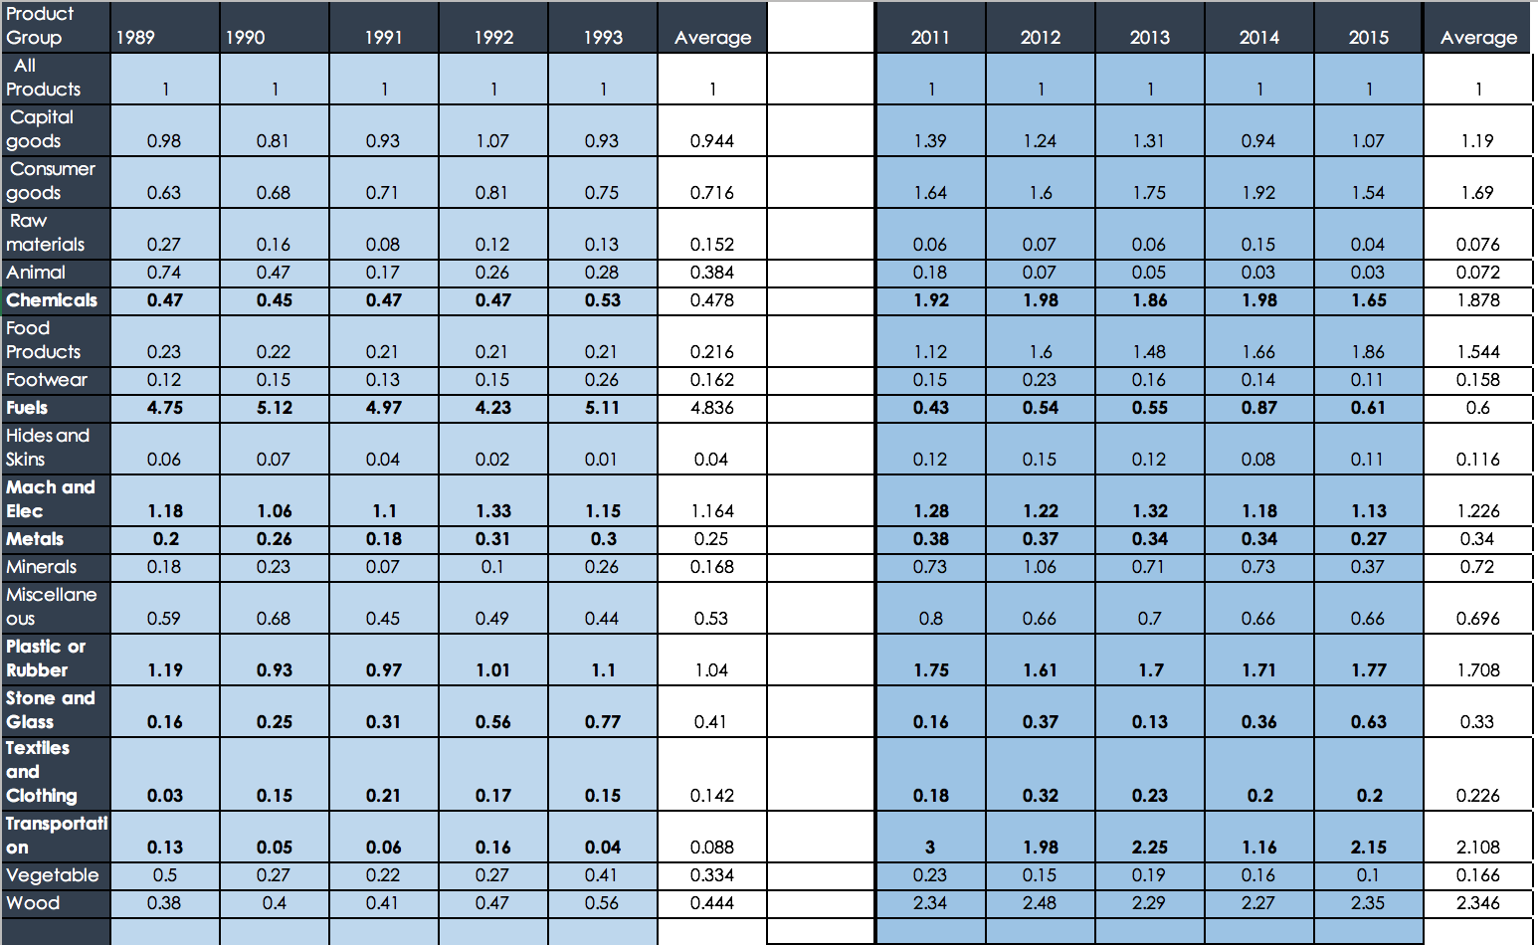
Revealed Comparative Advantage of Singapore Over Thailand

Slide 11
Assumptions for the Study of Trends
Capital Intensive | Labour Intensive
Machinery And Electronics | Textile And Clothing
Food Products | Vegetable
Plastic/ Rubber | Animal
Stone And Glass | Footwear
Metals | Wood
Transportation
Chemicals
Fuel

Slide 12
ANALYSIS
Singapore’s shift from labour intensive to capital intensive
Rapid Industrialization
Attracting foreign capital
Export Structure
Investment Patterns

Slide 13
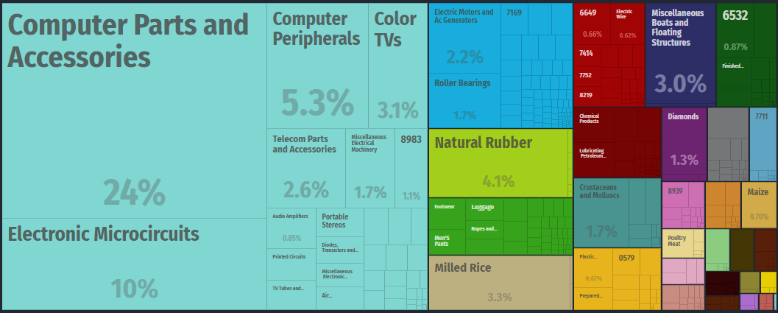
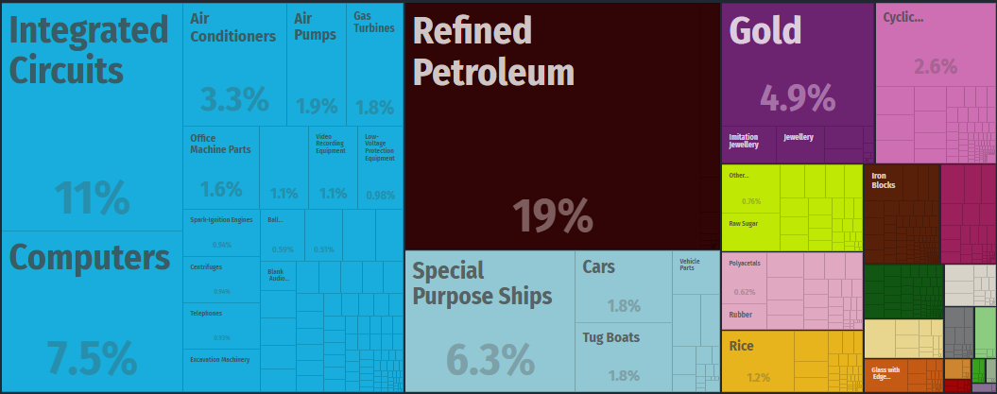
Comparative Advantage of Thailand in Past and Present
In 1991
In 2015

Slide 14
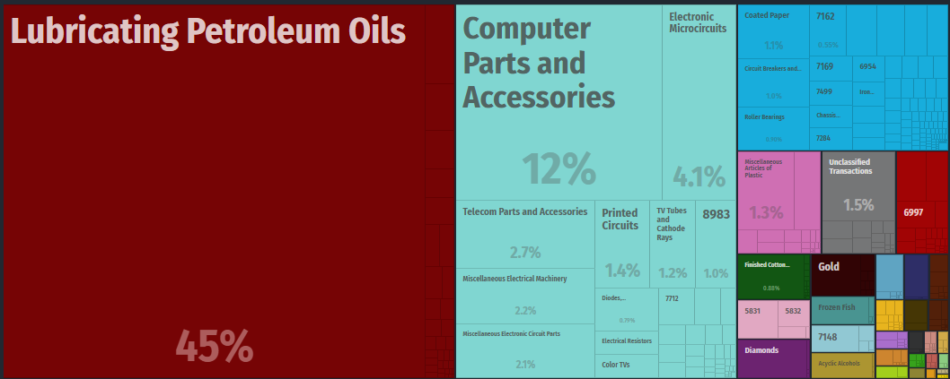
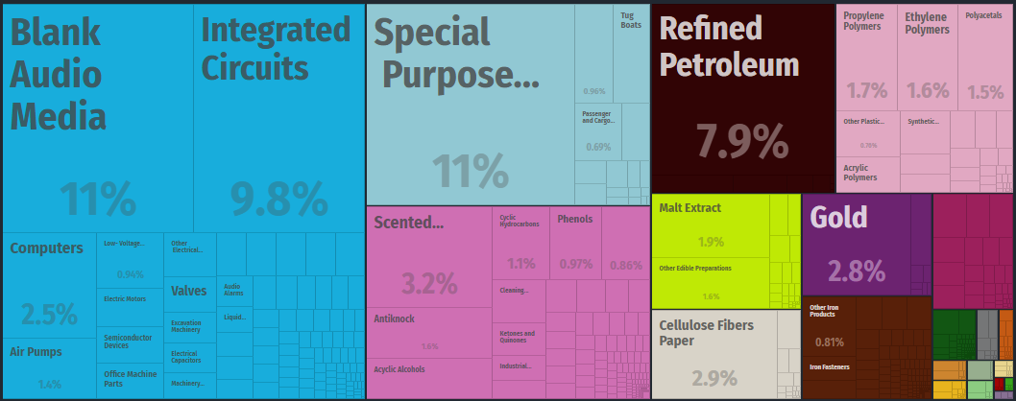
Comparative Advantage of Singapore in Past and Present
In 1991
In 2015

Slide 15
REASONS FOR INCREASING EXPORT MANUFACTURING
Free Trade Regime
Role of Economic Development Board
Skill Development of Labour
Decrease in Agriculture

Slide 16
Past and present Comparative Advantage of SINGAPORE
Product Group | Avg CA past
Fuels | 4.836
Mach and Elec | 1.164
Plastic or Rubber | 1.04
Capital goods | 0.944
Transportation | 0.88
Consumer goods | 0.716
Miscellaneous | 0.53
Chemical | 0.478
Wood | 0.444
Stone and Glass | 0.41
Product Group | Avg CA present
Hides and Skins | 2.3
Consumer goods | 1.854
machine and elec | 1.736
Miscellaneous | 1.718
Food Products | 1.692
Raw materials | 1.668
Animal | 1.206
Fuels | 1.078
Plastic or Rubber | 0.964
Wood | 0.746
Labour Intensive
Capital Intensive

